Slide 1
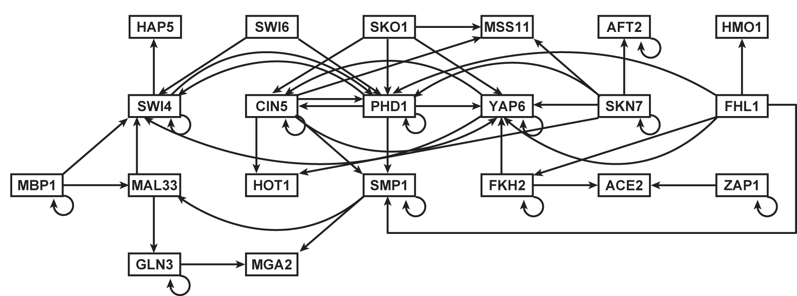
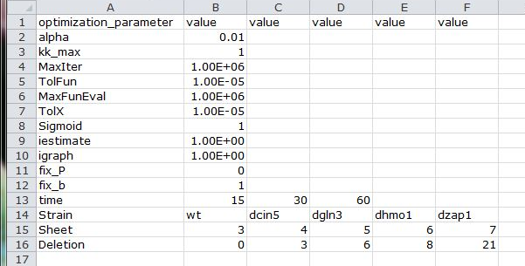
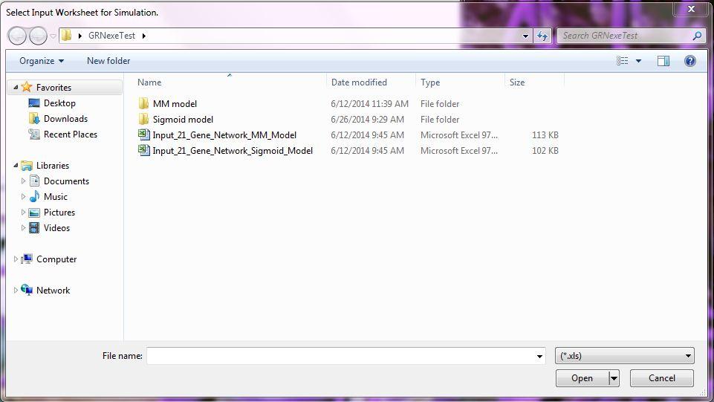
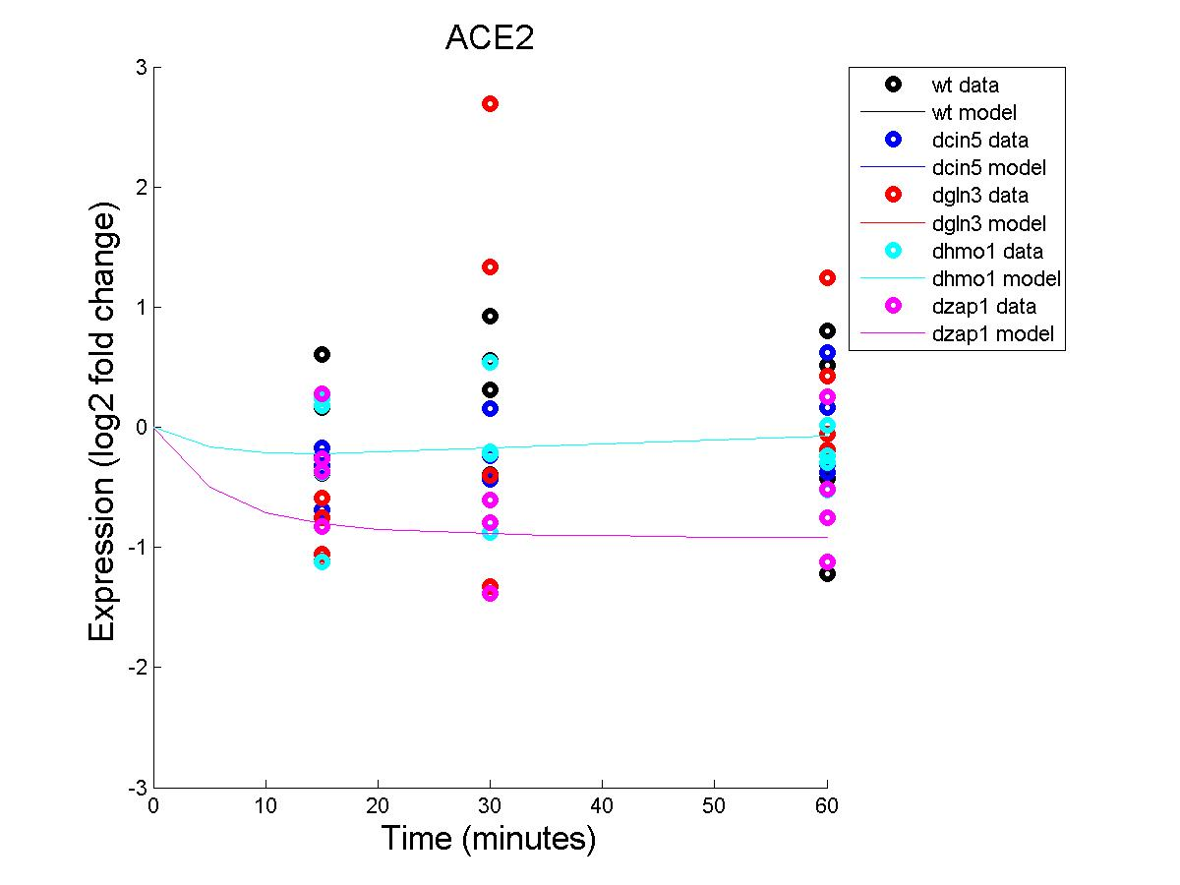
GRN Working Title
Juan S. Carrillo¹, Trixie Anne Roque¹, Kam D. Dahlquist², and Ben G. Fitzpatrick³
¹Department of Electrical Engineering and Computer Science, ²Department of Biology, ³Department of Mathematics,
Loyola Marymount University, 1 LMU Drive, Los Angeles, CA 90045 USA
Activity Diagram for GRNmap
Abstract
Mathematical Model
Running GRNmap
Unit Testing
A gene regulatory network (GRN) consists of genes, transcription factors, and the regulatory connections between them that govern the level of expression of mRNA and proteins from those genes. The dynamics of a GRN is how gene expression in the network changes over time. Over a period of several years, our group has developed a complex MATLAB software package, called GRNmap, that uses ordinary differential equations to model the dynamics of medium-scale GRNs from budding yeast, Saccharomyces cerevisiae. The program estimates production rates, expression thresholds, and regulatory weights for each transcription factor in the network based on DNA microarray data, and then performs a forward simulation of the dynamics of the network. The large number of developers and time span of development led to a code base that was difficult to revise and adjust. We therefore refactored the script-based software with global variables into a function-based package that uses an object to carry relevant information from function to function. This modular approach allows for cleaner, less ambiguous code and increased maintainability. We then used the MATLAB compiler to create an executable file that can be run on any Windows machine without the need of a MATLAB license, increasing the accessibility of our program. The GRNmap code and executable is available from http://kdahlquist.github.io/GRNmap/ under an open source license. We have now adopted a test-driven development framework that will speed debugging and ensure that future modifications to the code preserve correct functionality.
Our group had previously created a deterministic model in MATLAB which modeled the dynamics of how a gene regulatory network (GRN) of Saccharomyces cerevisiae, budding yeast, responds to the environmental stress of cold shock.
The GRN consisted of 21 nodes which represent the genes and the transcription factors they encode. The edges of the network represent the regulatory relationship, either activation or repression, which depends on the sign of the weight term in the model (Figure 1).
GRNmap takes in its parameters directly from the spreadsheet. The spreadsheet (Figure 2) is expected to have the following information:
Production rates – Initial guess
Degradation rates – Provided by user from data
Expression Thresholds – Initial guess
Microarray data - log 2 fold change of expression
Standard deviation for data
Adjacency matrix to describe the graph for the GRN
Initial guess for the network weights
Simulation times
Optimization parameters, including which model to use, whether or not to perform a forward simulation, whether or not to set certain parameters, and whether or not to include plots for the genes
In order to efficiently and effectively maintain the MATLAB package, a unit testing framework is created. Unit testing, a method for checking whether individual units of a software program function as intended, ensures that every change we make to the code does not affect its functionality. Unit testing allows for better means of pinpointing specific problems in the program by breaking up its operations into smaller parts and then inputting values to which we know the answer.
Results
DEFINE main function
CALL functiontests (localfunctions) to make a tests array
END
DEFINE function firstTest (testCase)
actualOutput = evaluate function by using known inputs
expectedOutput = assign expected results
VERIFY actualOutput equals expectedOutput
END
Figure 5. Pseudocode for Unit Testing Framework
Figure 1. Gene regulatory network
Summary
The rate of change in expression of each gene (x_{i}) in the network is modeled by a differential equation (Equation 1)
Figure 2. Optimization Parameters Sheet
GRNmap, a MATLAB program for gene regulatory network modeling and parameter estimation, had previously been developed by our group but the code needed to be reevaluated and improved.
Unit testing is currently being developed, which will allow future development to be done faster and ensure correctness.
GRNmap is user-friendly as it allows users to change parameters for the model without using MATLAB code.
GRNmap is accessible as it can be run on any Windows machine with the free MRC library installed.
Visit us at http://kdahlquist.github.io/GRNmap
Equation 1.
where p(x) is the production rate of the gene and λ_{i} is the degradation rate constant and x_{i} is the expression profile of the gene.
We model the production term, p(x), using two different models, the sigmoid model (Equation 2) and the Michaelis-Menten model (Equation 3).
Figure 3. Dialog Box for choosing spreadsheet
Equation 2.
Equation 3.
When GRNmap is run a dialog box will open to allow the user to select the spreadsheet(Figure 3). After GRNmap is finished it will output an estimation spreadsheet and .mat file. The estimation workbook contains a sheet with the optimized network weights. GRNmap will also output MATLAB figures containing the plots of the gene expression over time for each gene.
In the Sigmoid model, P_{i} is the production rate constant of a particular gene i, w_{ij} is the production weight of transcription factor j, and b_{i} is the expression threshold. For the Michaelis-Menten model, P_{i} is the production rate of the gene, the first bracketed term is the relative weight of a gene j, the second bracketed term represents the Michaelis-Menten reaction rate, and the third term models the effects of repression.
Future Work
Making GRNmap more accessible by possibly including radio buttons and check boxes in Excel rather than typing values in cells.
We will integrate GRNmap with GRNsight (http://dondi.github.io/GRNsight/), a web application and service that is being developed to visualize the results of the GRNmap modeling.
GRNmap takes as input DNA microarray data which is provided as log₂ ratios of expression for each gene in the network. Written in MATLAB, the GRNmap software loads an Excel spreadsheet as input. The software makes heavy use of two MATLAB functions: ODE45 and FMINCON. We used ODE45 to solve the model’s differential equation (Equation 1) and we used FMINCON to estimate the parameters of the model using a penalized least squares fit criterion.
The model estimates the production rates, weights, and expression thresholds. The model then performs a forward simulation using those parameters so that model-generated expression data can be compared to the experimental data input to the model.
Acknowledgments
Figure 4. Sample of plot generated by GRNmap
We would like to thank Nicholas A. Rohacz, Alondra Vega, Stephanie D. Kuelbs, Nathan C. Wanner, and Erika T. Camacho for previous work on the GRNmap program. This project was supported by the Summer Undergraduate Research Program at Loyola Marymount University (J.S.C.), NSF-DMS award #0921038 (K.D.D., B.G.F., and K.S), and the Clarence Wallen, S.J. Chair in Mathematics (B.G.F.).
GRNmap outputs an Excel spreadsheet with the optimized parameters and resulting simulated gene expression profiles, a MAT file containing the calculated values, and plots corresponding to each gene in the network showing gene expression over time.
To see GRNmap applied to some problems of network selection, please see the poster "Comparing the Dynamics of the Cold Shock Gene Regulatory Network in Yeast with a Random Network" by Johnson and Williams.

